Slide 1
Agile and Scrum
An approach and a Framework for Software Development

Slide 2
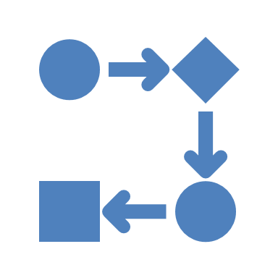
What is Agile?
Agile is a project management and software development approach.
Delivers value to customers in small increments.
Focuses on flexibility, collaboration, and customer satisfaction.

Slide 3
Agile Principles
Customer satisfaction through early and continuous delivery.
Welcome changing requirements, even late in development.
Deliver working software frequently.
Collaboration between business people and developers.
Build projects around motivated individuals.
Face-to-face conversation is the most effective communication.
Working software is the primary measure of progress.

Slide 4
Agile Methodologies
Scrum – Sprints, defined roles, and meetings.
Kanban – Visual task boards, continuous delivery.
Extreme Programming (XP) – Test-driven development, pair programming.
Lean – Eliminating waste, maximizing value.

Slide 5
What is Scrum?
Scrum is a framework within Agile.
Organizes work into time-boxed sprints (2–4 weeks).
Roles: Product Owner, Scrum Master, Developers.

Slide 6
Scrum Process
Product Backlog – List of all desired work.
Sprint Planning – Selects items for the sprint.
Sprint – Time-boxed development phase.
Daily Standup – Short daily team meeting.
Sprint Review – Showcase completed work.
Sprint Retrospective – Reflect and improve.

Slide 7
Agile vs Scrum
Agile: Philosophy with flexible principles.
Scrum: Framework within Agile with structure.
Agile: No strict roles; Scrum: Defined roles (Scrum Master, Product Owner, Team).
Agile: Broad methods; Scrum: Sprint-based.

Slide 8
Real-World Examples
Spotify uses Agile squads and chapters.
Google uses Kanban boards in product teams.
Salesforce and IBM have adopted Scrum in teams.

Slide 9

Benefits and Challenges
Benefits: Faster delivery, higher quality, better feedback.
Benefits: Encourages teamwork and adaptability.
Challenges: Requires cultural shift.
Challenges: Difficult in fixed-budget environments.

Slide 10
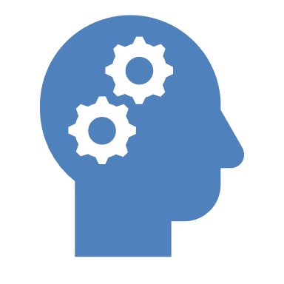
Conclusion
Agile is a mindset emphasizing flexibility and collaboration.
Scrum is a structured framework within Agile.
Both are key to modern software development success.

